Slide 1
IPL 11 The dream team
Problem Statement:
WE DON’T KNOW THE STRENGTHS AND WEAKNESSES OF OUR OPPONENTS BUT GIVE ME THE BEST 11 FROM THIS PLANET.”
The team should be able to score at least 180 runs on an average.
They should be to defend 150 runs on an average.

Slide 2

OPENERS
PARAMETERS | DESCRIPTION | CRITERIA
Batting Average | Avg runs scored in an Inning | >30
Strike rate | No. of runs scored per 100 balls | >140
Innings batted | Total Innings batted | >3
Boundary % | % of runs scored in boundaries | >50
Batting position | Order in which the batsmen played | <4

Slide 3

ANCHORS / MIDDLE ORDER
PARAMETERS | DESCRIPTION | CRITERIA
Batting Average | Avg runs scored in an Inning | >40
Strike rate | No. of runs scored per 100 balls | >125
Innings batted | Total Innings batted | >3
Avg. balls faced | Average balls faced by the batter in an innings | >20
Batting position | Order in which the batsmen played | <4

Slide 4

FINISHER / LOWER ORDER ANCHOR
PARAMETERS | DESCRIPTION | CRITERIA
Batting Average | Avg runs scored in an Inning | >25
Strike rate | No. of runs scored per 100 balls | >130
Innings batted | Total Innings batted | >3
Avg. balls faced | Average balls faced by the batter in an innings | >20
Batting position Innings bowled | Order in which the batsmen played Total innings by bowler | <4 >1

Slide 5

ALL-ROUNDERS / LOWER ORDER
PARAMETER | DESCRIPTION | CRITERIA
Batting Average | Avg. runs scored in an Inning | >15
Strike rate | No. of runs scored per 100 balls | >140
Innings batted | Total Innings batted | >2
Batting position | Order in which batsmen played | >4
Innings bowled | Total innings bowled | >2
Bowling Economy | Average runs allowed per over | <7
Bowling Strike rate | Avg. No. of balls required to take a wicket | <20

Slide 6

ALL-ROUNDERS / LOWER ORDER
PARAMETERS | DESCRIPTION | CRITERIA
Innings bowled | Total innings bowled | >4
Bowling Economy | Avg. runs allowed per over | <7
Bowling strike rate | Average no. of balls required to take a wicket | <16
Bowling Style | Bowling style of the player | FAST/PACER/MEDIUM/SPIN
Bowling Avg. | No. of runs allowed per wicket | <20
Dot Ball % | % of dot balls bowled | >40

Slide 7
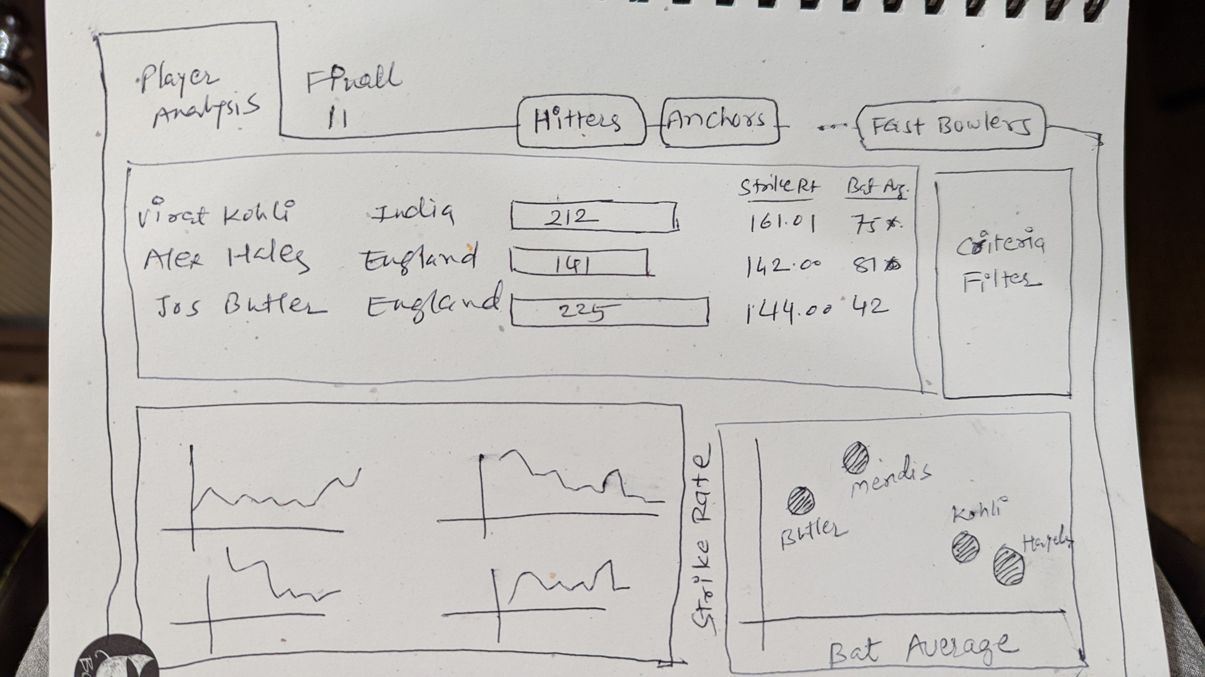
LAYOUT OF THE DASHBOARD

Slide 8
Player Analysis
Navigation between different player roles
Combined Strength of one or more players
Player Analysis with all ‘parameters’ as per player role / position
Criteria Filter
Player Trend for different parameters
Scatter plot of Bat Avg vs Strike rate or other relevant parameters

Slide 9
Final 11
Navigation between Player Analysis & Final 11
Player selection panel with search bar
Final team selection with parameters
Combined team strength on key parameters

Slide 10
Tool Tip when hovered over player name
Player Profile
Batting Stats Per Match
Bowling Stats Per Match

